Slide 2
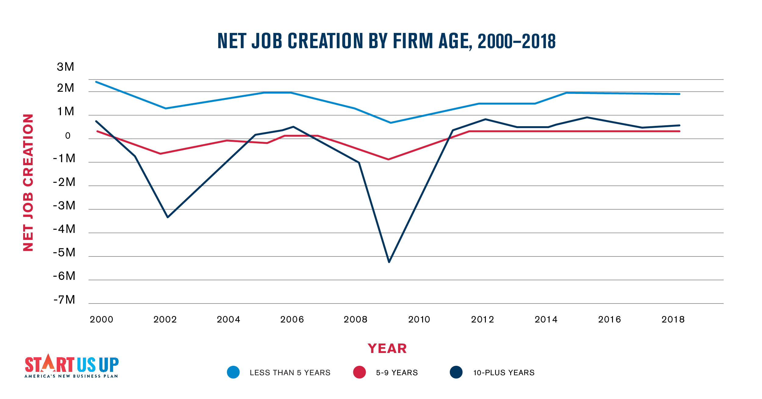
*Data from the Bureau of Labor Statistics
2
| START US UP

Slide 3

America is experiencing a troubling and persistent period of entrepreneurship stagnation. For the past 20 years, the rate of new entrepreneurs has essentially been flat.
★
*Source: Ewing Marion Kauffman Foundation Indicators of Entrepreneurship

Slide 4
THE PROBLEM
Entrepreneurship suffers from an uneven playing field. Without access to personal wealth and lobbyists, new businesses are far more likely to fail – with women, people of color, and rural residents facing unique barriers to starting their own businesses.
Meanwhile, policymakers misguidedly prioritize big business over new business, handing out billions in corporate subsidies to large corporations.

Slide 5
★
Rather than throwing billions in incentives to lure Amazon to their states, consider what would have been possible if policymakers instead invested a fraction of that in entrepreneurs.

Slide 6
AMERICA’S NEW BUSINESS PLAN
America’s New Business Plan is a bipartisan policy roadmap to support entrepreneurs, with recommendations for federal, state, and local government.

Slide 7
AMERICA’S NEW BUSINESS PLAN
So, what do entrepreneurs need? It’s pretty simple.
Opportunity: A Level Playing Field and Less Red Tape
Funding: Equal Access to the Right Kind of Capital Everywhere
Knowledge: The Know-How to Start a Business
Support: The Ability for All to Take Risks

Slide 8
OPPORTUNITY
New and small businesses do not have the same resources that big, established businesses have to navigate complex regulations.
We need to level the playing field and cut red tape that holds entrepreneurs back.

Slide 9

FUNDING
At least 83% of entrepreneurs do not access bank loans or venture capital when launching a business.
We need to create equal access to the right kind of capital entrepreneurs need.

Slide 10
KNOWLEDGE
Many entrepreneurs were not taught the skills needed to successfully launch a business during their formal education and training.
We need to help entrepreneurs get the skills and know-how they need to be successful.

Slide 11
SUPPORT
Becoming an entrepreneur is a courageous act, but many feel it is currently out of their reach.
We need a stronger safety net that supports entrepreneurial risk-taking.

Slide 12
AMERICA’S NEW BUSINESS PLAN
America’s New Business Plan contains specific steps policymakers can take to strengthen entrepreneurship. These include:
Create an Entrepreneurship Impact Statement.
Develop state and local Entrepreneurial Capital Catalyst Grants.
Integrate entrepreneurship into K-16 education.
Provide entrepreneurs relief from student loan debt.

Slide 13
A PLAN BY AND FOR ENTREPRENEURS
America’s New Business Plan is informed by:
Public polling and surveys of entrepreneurs.
Conversations with nearly 50 leaders in the entrepreneur community, including successful entrepreneurs like Steve Case.
Research and data on entrepreneurship.

Slide 14
START US UP
Start Us Up is a diverse coalition of voices working together to elevate the importance of entrepreneurship and support America’s New Business Plan.
As disparities in access linger and policymakers continue to favor large corporations, we know America’s entrepreneurs need a level playing field and the tools to succeed.
We’re here for them.

Slide 15
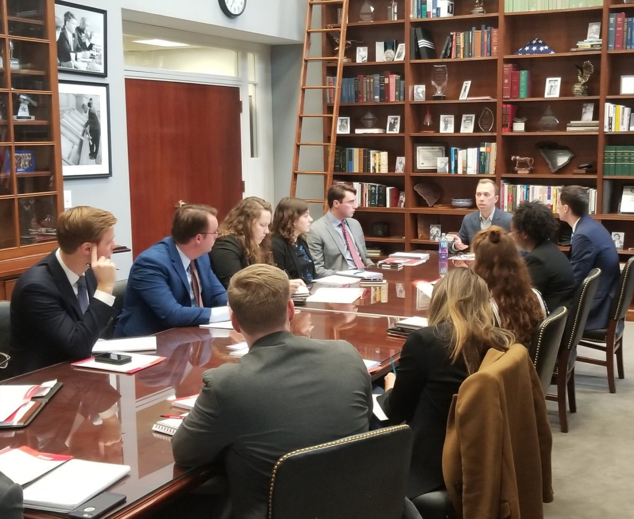
WHAT WE’VE DONE
America’s New Business Plan is intended to help policymakers understand what they can do to support entrepreneurs. To accomplish this, we’ve presented the plan to:
U.S. House and Senate staff
National Lieutenant Governors Association
NewDEAL Leaders
State legislators and local officials

Slide 16
WHY ADVOCACY MATTERS
Engagement from champions like you is the single most important component of this effort.
The more support we have, the more policymakers will listen.
We’re beginning to see traction for America’s New Business Plan across the country.
Policymakers need to hear from you.

Slide 17
WHAT CAN YOU DO?
It’s easy to get involved. Here’s how:
Follow @StartUsUpNow on Twitter and Facebook.
Join the Start Us Up coalition and sign up for our mailing list at StartUsUpNow.org.
Tell policymakers to support new businesses.

